Slide 1
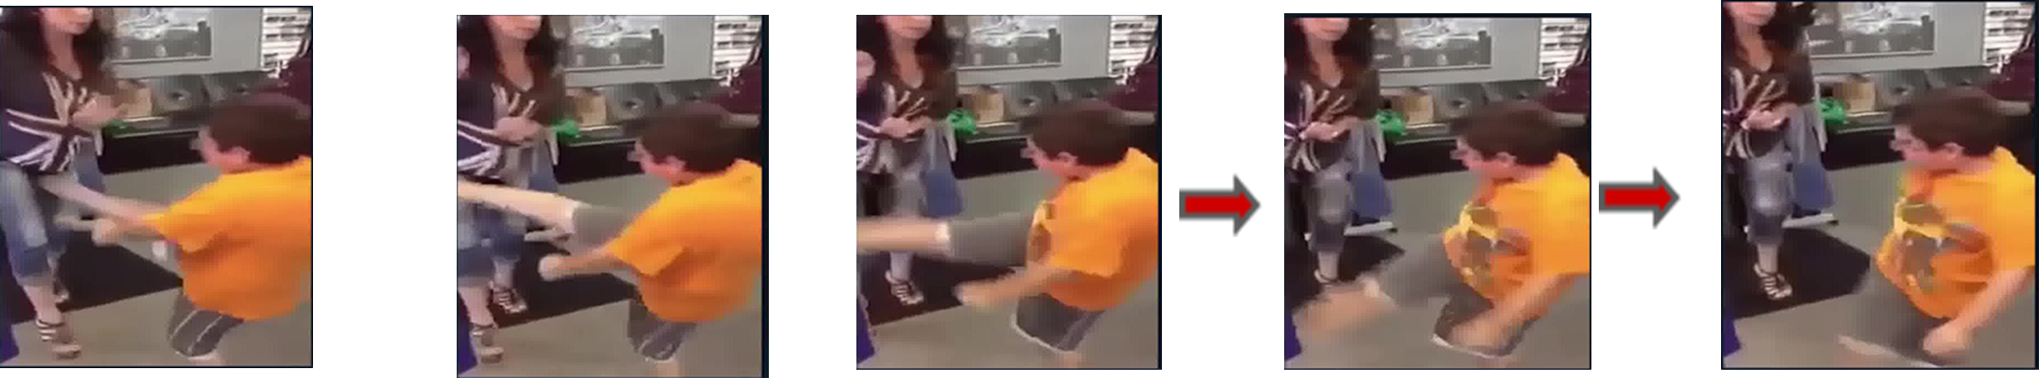
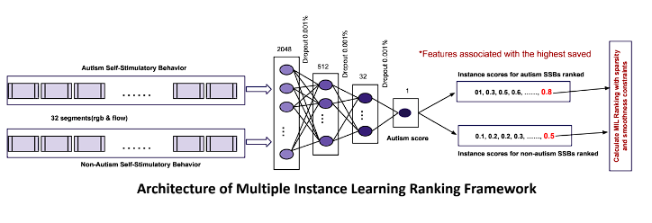
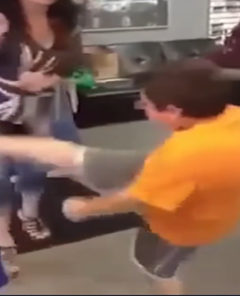
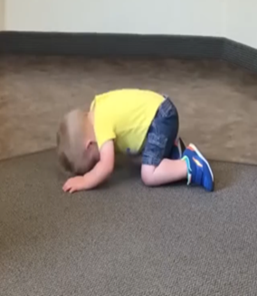
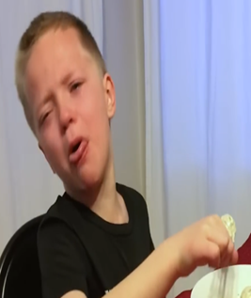
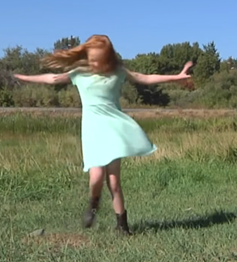
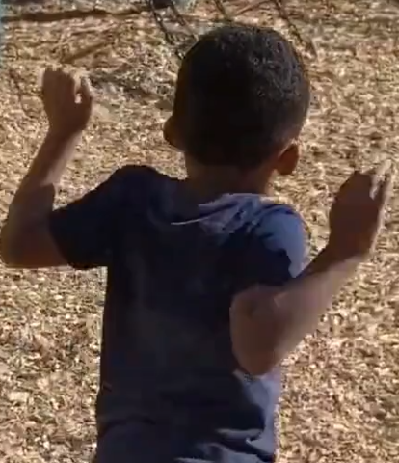







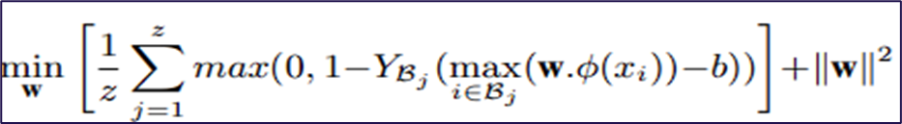
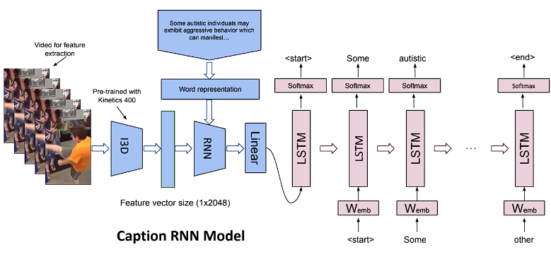
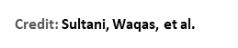
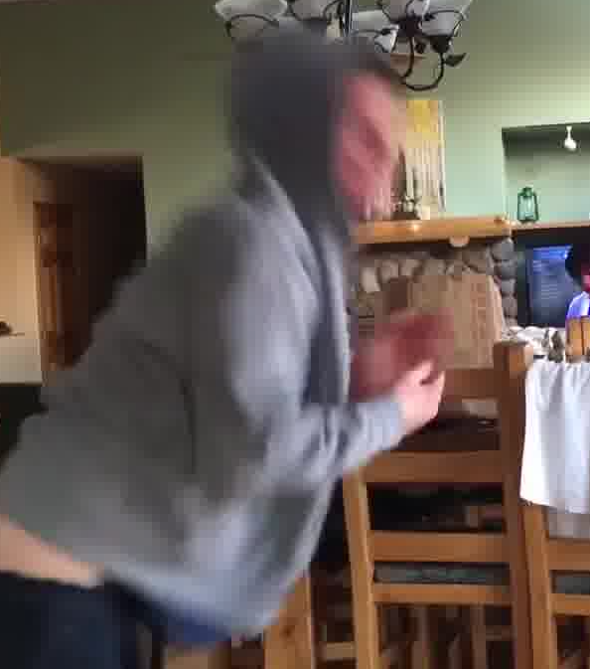
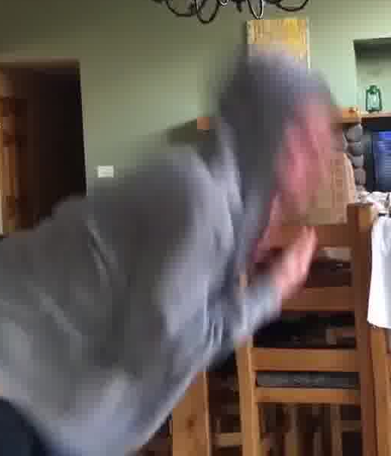
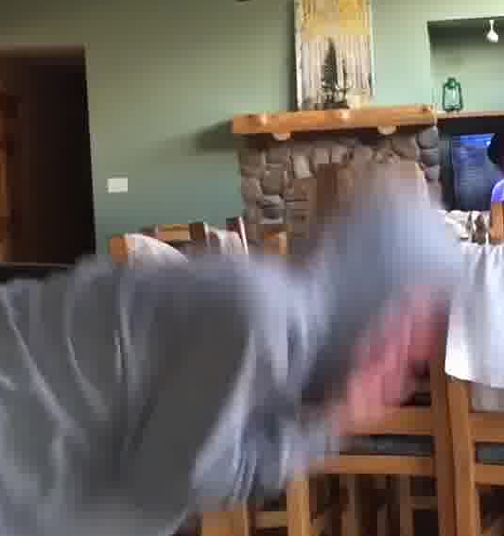
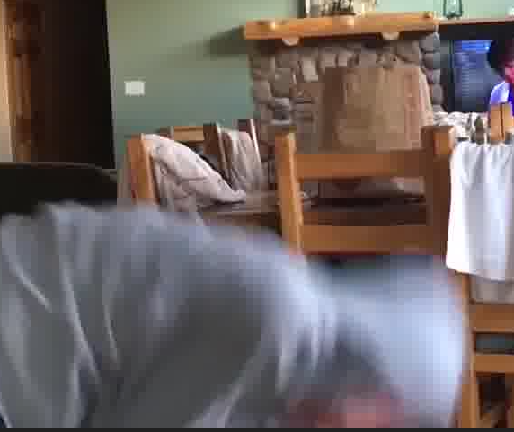
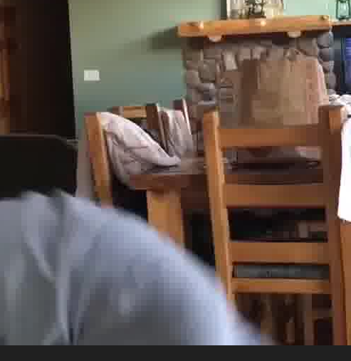
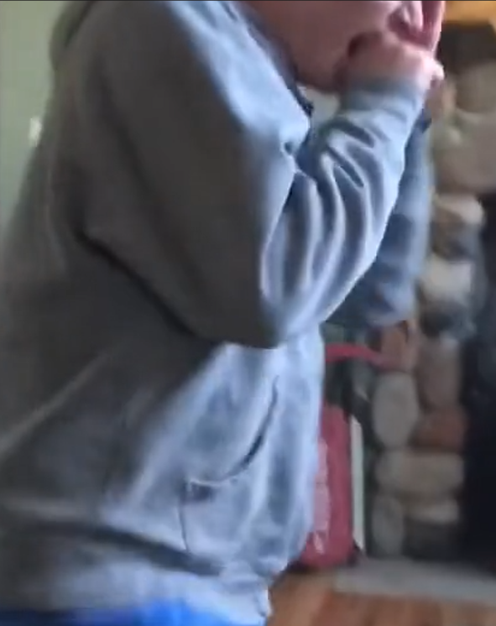
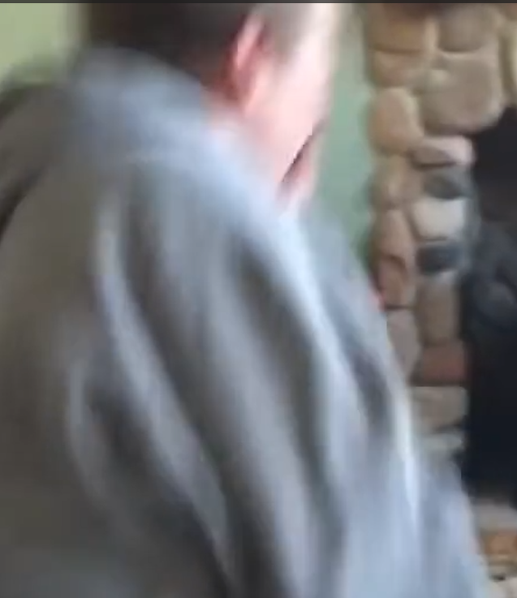
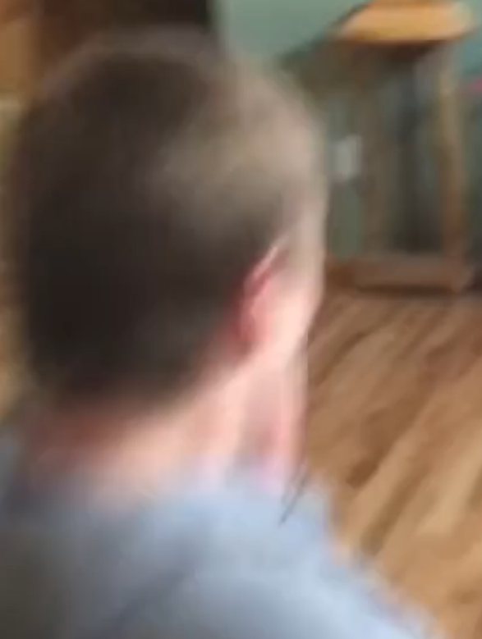
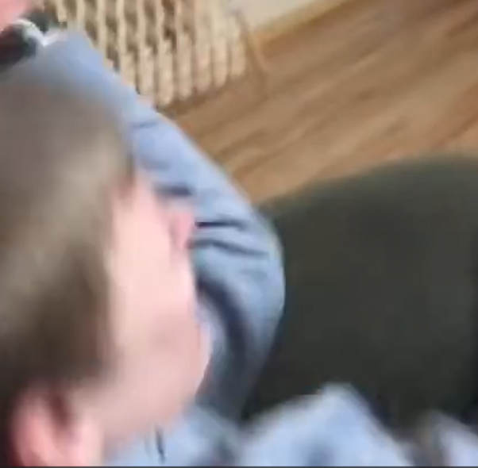
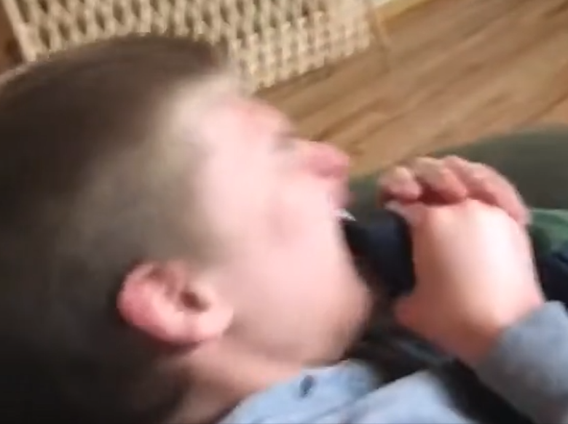
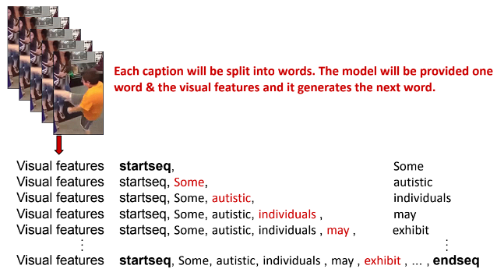

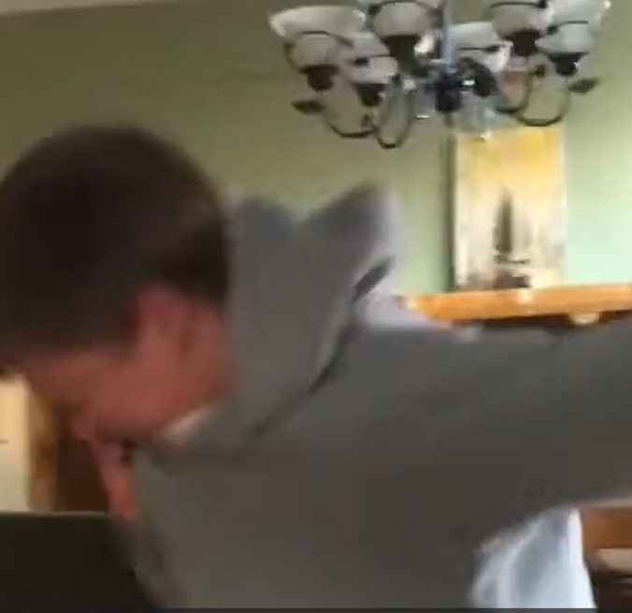
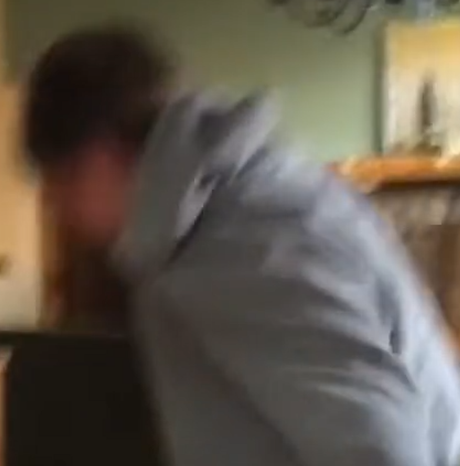
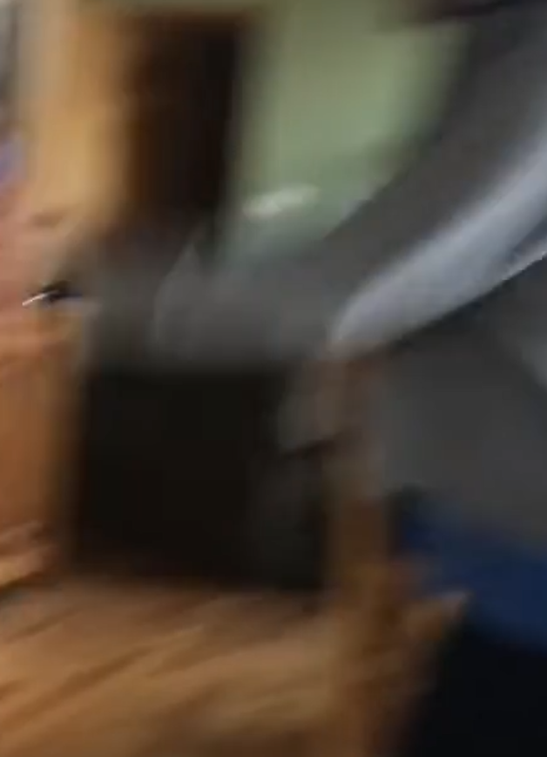
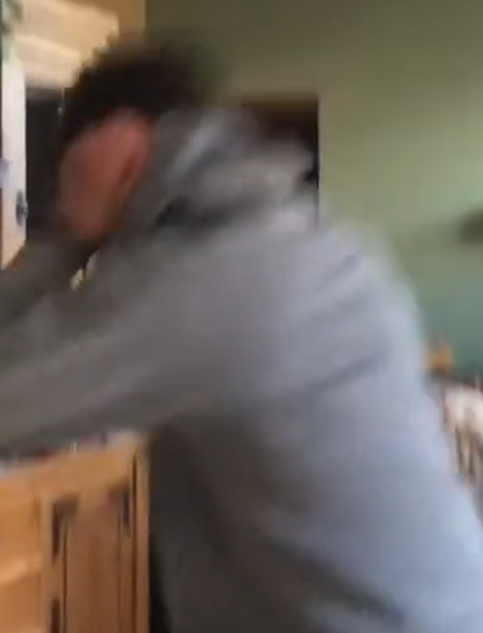
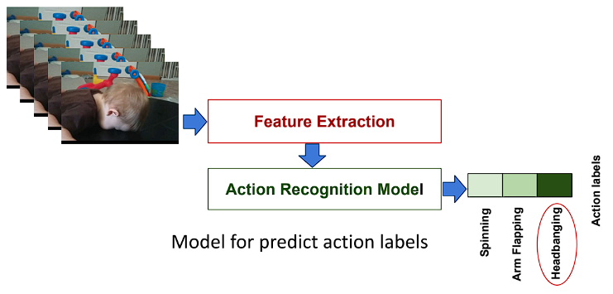
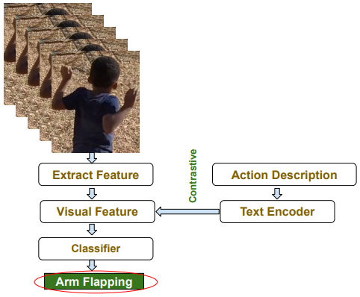
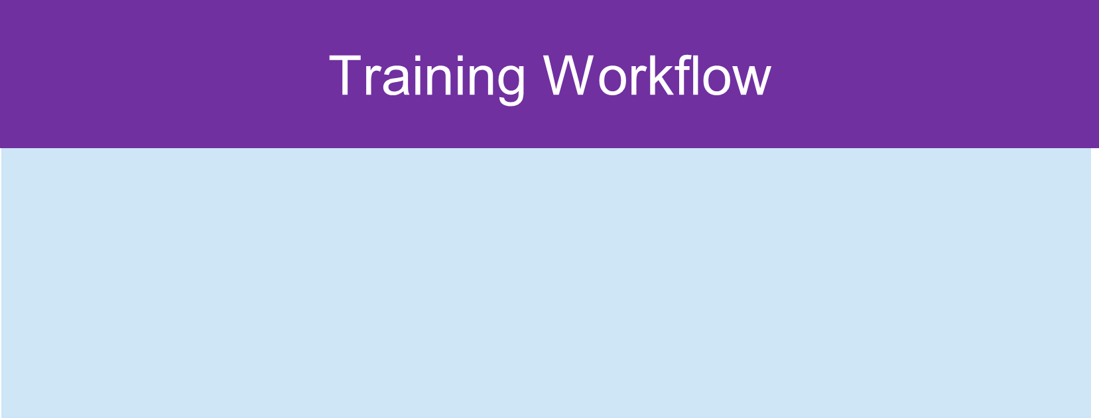
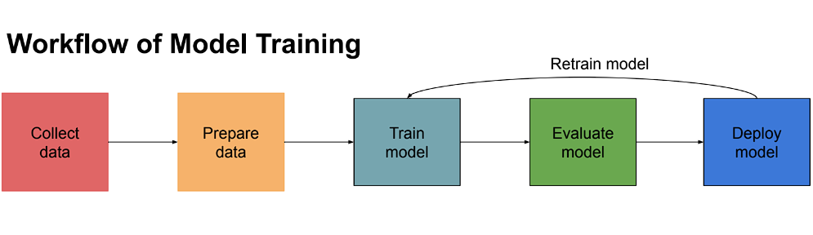
Self-Stimulatory Behavior Detection and Captioning for ASD:
A Multiple Instance Ranking Framework with Video Captioning (MILC)
Unless otherwise noted, all figures, images, and data plots were created by the researcher
Background
Video Dataset Pre-Process
& Feature Extraction
Multiple Instance Learning Ranking Framework(MIL) Design
MILC Model Results
Autism Spectrum Disorder (ASD)
Autism Spectrum Disorder (ASD) is a group of complex neurodevelopmental disorders that impact the person's ability to function in school, work, and other areas of daily life. Symptoms of ASD can last through a person's lifetime without cure. The prevalence of ASD has increased by 300% from 2000 to 2020. About 20-30 percent of children with ASD develop epilepsy by the time they reach adulthood. Early diagnosis is very important since timely professional interventions can improve a child's development and result in better outcomes.
Self-Stimulatory Behaviors(SSB)
Self-Stimulatory Behaviors (SSB) is one of the main indicators for detecting children with autism. SSB is repetitive body movements or repetitive movements of objects. There are five typical SSBs:
Video Dataset Pre-Processing:
Using MoviePy.FFMpeg tool to trim videos
Annotating at the Folder level (weakly supervised labeling)
Video Feature Extraction Parameters
Inflated 3D backbone for two-steam: RGB and Flow
Pre-trained I3D on Kinetics 400
Settings: Stack size=16, Step size=16, and FPS=30 non-overlapping
Default settings for all other parameters for I3DFeature numpy array size: e.g.[128, 1024]
Instance Segmentation
Dividing feature numpy arrays into 32 segments
Repeating feature numpy arrays if less than 32 segments
MIL Ranking Framework is employed to identify the highest-scored feature in a video by utilizing the loss computed from both autism and non-autism features.
This video has been captioned with aggressive behavior and this has been confirmed by checking the video
Frames from a video are classified as aggressive behavior with the following caption:
Some autistic individuals may exhibit aggressive behavior, which can manifest as physical aggression (e.g., hitting, kicking, biting), verbal aggression (e.g., shouting, insults), or destructive behavior (e.g., breaking objects). Such aggression may be a response to a range of factors, such as overwhelming sensory environments, difficulty with social interactions, or frustration stemming from communication difficulties.
(Credit: UTD CVMC Lab)
Caption RNN Model Design
Aggressive Behavior Head Banging Hyper/ hypo reactivity spinning Upper-limb stereotypie
Challenges of ASD diagnostic process through SSB
Shortage of professionals: around 1 clinician for every 1000 autistic children.
Prolonged diagnostic process: long questionnaire and time- consuming observation process
Expensive and labor-intensive process of traditional diagnosis in small towns and rural areas
Caption Recurrent Neural Network(RNN) is used to generate captions for video features, employing an RNN with BEAM Search.
MILC detected three different types of SSB correctly in one video clip:
(Credit: UTD CVMC Lab)
MIL Ranking enables ranking to occur in a multiple-instance learning setting.
The motivation for ranking is to acquire the strongest feature in a video clip, enhancing the folder-level annotation.
The model predicts scores that are defined as instances: autism is a positive instance and non-autism is a negative instance. The feature with the highest score is saved as input for the caption RNN model.
The features from the 32 segments for positive and negative instances go through three fully connected layers, and each segment is scored. The segment with the highest score is saved as output.
Head Banging
& Hitting
Research Question
How can the application of AI-based action recognition techniques in video analysis contribute to the early detection and accurate diagnosis of autism spectrum disorder (ASD)?
Aggressive
Behavior
Literature Review
Some Researchers studied Self-Stimulatory Behavior detection or action recognition for autistic children using video analysis. The stereotypies are constrained in three or four types. Their models can predict only one action such as headbanging or arm flapping. There are two action recognition models for label prediction:
Spinning
Head Banging & Hitting:
Some individuals on the autism spectrum may engage in self- injurious behaviors such as head-banging or hitting themselves. these behaviors can serve a number of functions including self- stimulation a reaction to sensory overload a means of expressing distress or a way to communicate needs.
(Credit: UTD CVMC Lab)
Model Training & Testing
Aggressive Behavior:
Some autistic individuals may exhibit aggressive behavior, which can manifest as physical aggression (e.g., hitting, kicking, biting), verbal aggression (e.g., shouting, insults), or destructive behavior (e.g., breaking objects). Such aggression may be a response to a range of factors, such as overwhelming sensory environments, difficulty with social interactions, or frustration stemming from communication difficulties.
Model for predict action labels
(Credit: UTD CVMC Lab)
Model for action labels
Limitation of Current Approach:
1). Previous models predict action labels only. The annotated videos depict four actions: Spinning, Arm Flapping, Headbanging, and Hand Action. In real life, multiple Self-Stimulatory Behaviors often happen to children in videos. The models report only the dominant action and ignore the rest. 2). Sparsity of the dataset, imbalance of representations, and noise in videos lead to low accuracy and unreliable detection results. 3). No web or mobile apps currently leverage the developed prediction models.
Research Goal:
My research goal is to develop a deep learning system aimed at enhancing the diagnostic process of Autism Spectrum Disorder (ASD).
Collect Data
Prepare data
Train model
Evaluate model
Deploy model
Spinning:
Spinning or twirling, either in place or with objects, is another behavior sometimes observed in individuals on the autism spectrum. This could be a form of self-stimulation (also known as stimming), providing sensory input that is calming or focusing, or this behavior could be a way of coping with a stressful or over stimulating environment.

Slide 2
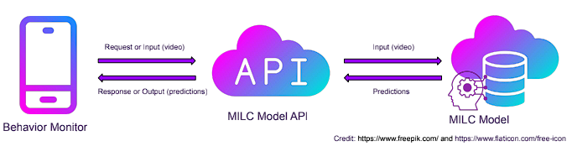
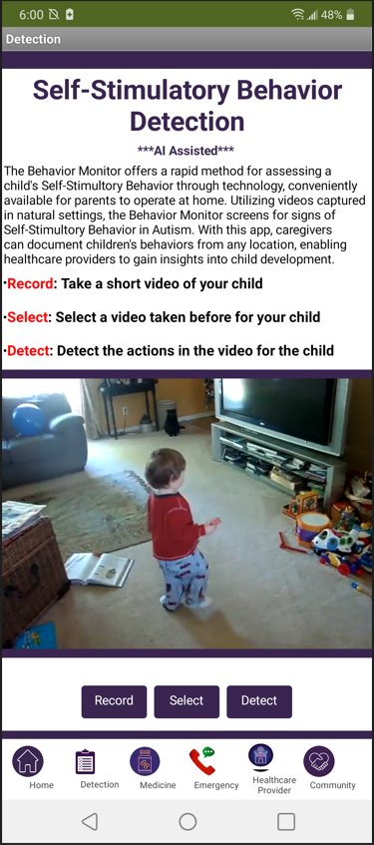
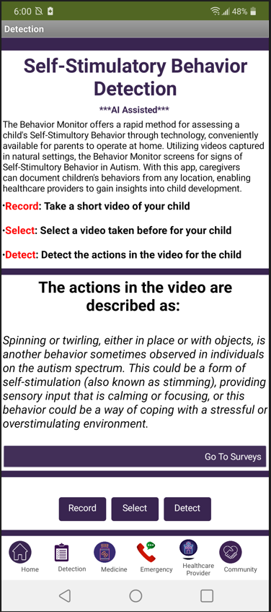
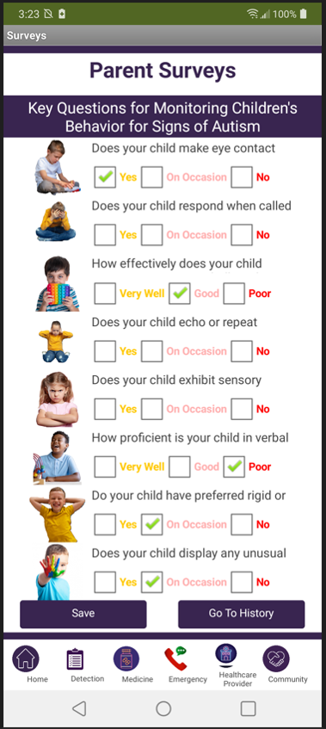
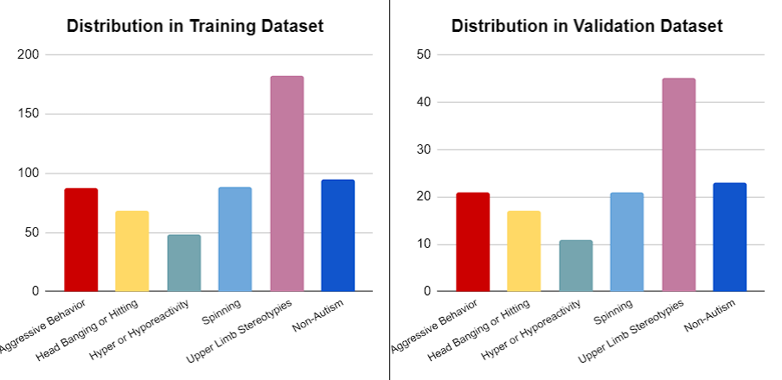
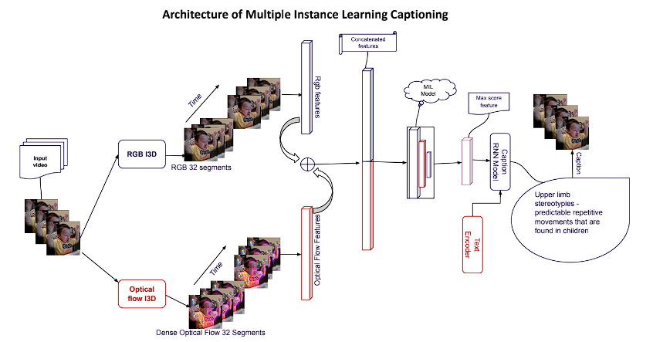
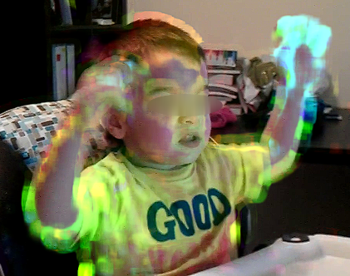
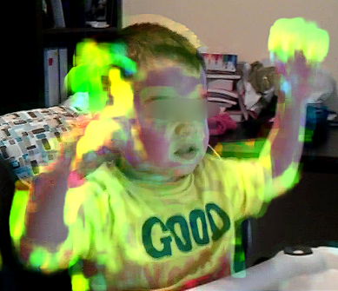
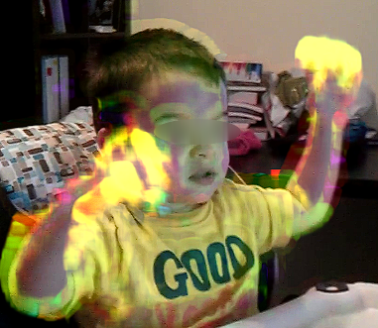
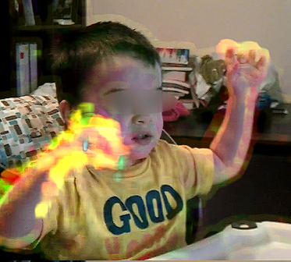
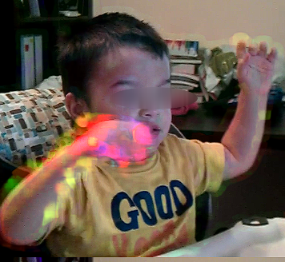
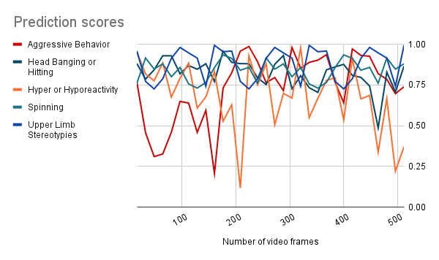

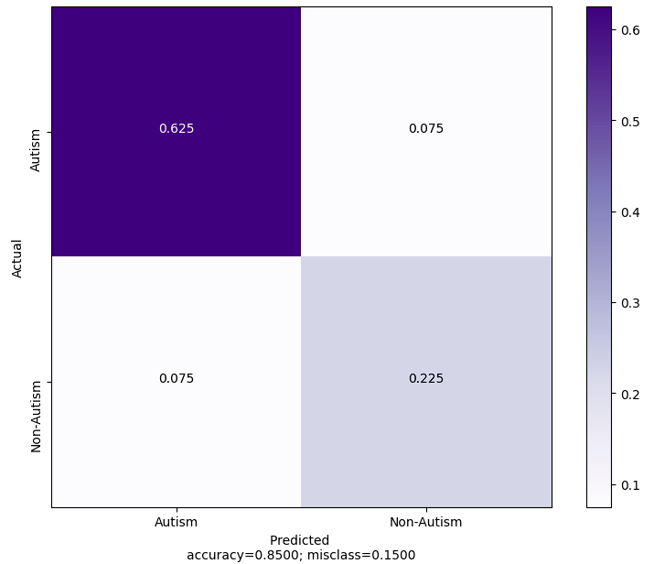
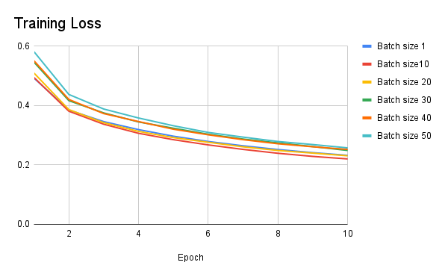
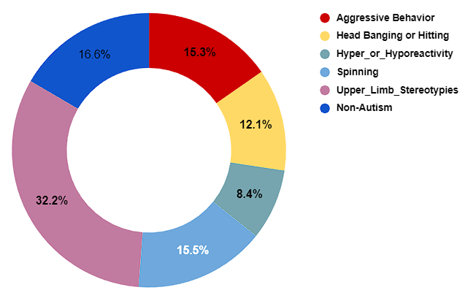
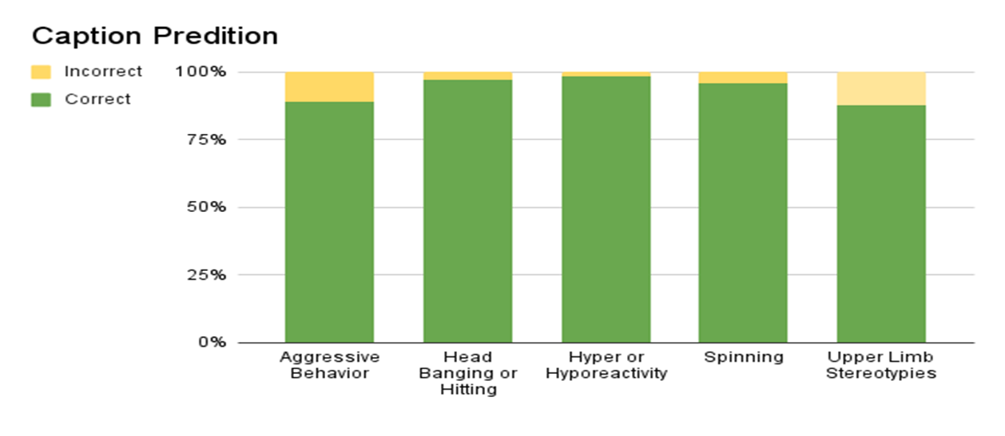
Research Proposal
MIL Model Training
Caption RNN Model Training
Mobile App Prototype
New Idea: MIL Combined with Caption RNN (MILC)
Model Parameters:
Learning rate: 0.001
Weight decay: 0.0010000000474974513
Optimizer: Adagrad
Input dimension: [32, 2048]
Drop out: 0.001 (~0.6)
I3D: stack size 16, step size 16, and 30FPS.
32 16-frame segments(clip)
Model Parameters:
Input dim (2048D)
Three-layer FC neural network
First FC layer: 512 units
Second FC layer: 32 units
Last FC layer: 1 unit
ReLU activation: first layer
Sigmoid activation: last layer
Architecture of the Behavior Monitor
A new SSB of ASD dataset has been collected and annotated by UTD CVMC Lab. The dataset has redefined the SSB actions. It contains eight categories of actions. The definition of the actions takes consideration of SSB overlapping. The new dataset opens the door for further investigation of SSB in autism.
This research will be focused on developing a novel model based on five actions from the dataset to predict self-stimulatory behaviors (SSB) in videos and generate detailed action descriptions as output.
My research approach:
1). Utilizing the feature extraction backbone of the Inflated 3D (I3D) model for two-stream feature extraction; 2). Processing these features through the Multiple Instance Learning (MIL) ranking framework to identify the strongest features. 3). Inputting these identified features to the Caption RNN model, in conjunction with a text encoder, to generate a detailed description of the prediction of SSBs by LSTM (Long Short Term Memory) algorithm. 4) Converting the model into API; 5). Creating a mobile app to call the model API
Beam Search:
K = 3 BLEU Scores on Validation data (the higher the better)
BLEU_1
BLEU_2
BLEU_3
BLEU_4
Training Parameters:
Action description maximum length: 52
Beam search K value:3
Embedding size: 300
LSTM unit: 256
Dense unit: 256
Drop out: 0.3
Video feature Input size: (1, 2048)
Model & Configuration:
I3D +RNN
Epochs = 10-40
Batch Size = 16
Optimizer = Adam
(Credit: Image from UTD CVMC Lab)
(Credit: Free Images Online)
The Benefits of this App:
Time-saving: Drastically reduces time spent on professional observation, potentially saving up to 5 hours.
User-Friendly: Simply use your smartphone to detect and receive scores, determining the level of Autism support required.
Convenient Monitoring Tool: Facilitates regular child development monitoring, such as every 3 months or at other intervals.
Cost-Effective: Requires only a smartphone and internet connection, offering a low-cost alternative compared to professional monitoring, especially in areas lacking sufficient professionals.
Results & Discussions
(MILC)
(1) I3D Optical flow
(2) MIL Results
Optical flow features captured in I3D
A glance at prediction scores generated by the MIL Ranking Framework
Conclusions & Future Work
By applying AI-based action recognition techniques in video analysis, this research creates a deep learning system to improve the diagnostic process of Autism Spectrum Disorder (ASD):
A novel multiple instance learning captioning model (MILC) has been developed based on multiple instance learning (MIL) and Caption Recurrent Neural Network (RNN) models to improve the SSB action recognition process.
MILC model extends the categorization of SSB from 3-4 categories established by institutional researchers to 5 categories to achieve an expanded model scope.
This model improves folder-level annotation by utilizing MIL to extract the strongest feature in each video clip.
MILC marks the first application of video captioning for SSB in ASD.
The designed model (MILC) has been trained and achieved an excellent accuracy of 93.5% in captioning SSB.
Multiple SSB can be identified at the same time and captioned correctly in videos. Other models can only identify one SSB at a time.
The validity of the multiple instance learning captioning model (MILC) has been confirmed by the new AV-ASD dataset collected from public sources by the UTD CVMC Lab.
A user-friendly mobile app called Behavior Monitor, based on the MILC model, has been created to aid the diagnostic process of Autism, offering both time and cost savings.
The AV-ASD dataset also includes videos that contain audio information. Future work will be focused on analyzing the audio portion of the video to further improve the ASD diagnostic process.
(3) MIL Model Performance Evaluation
Achieved 84.5% AUC when the model was evaluated
The test dataset was not created
The confusion matrix is based on the validation
(Credit: UTD CVMC Lab)
MIL model training loss
Project Design
Dataset Information
AV-ASD collected from public sources by the UTD CVMC Lab
Eight SSB categories in original videos
Annotation done by a paid clinician
Five SSB categories plus No-Autism used in this project
(4)Caption RNN model performance evaluation
Number of videos:
Aggressive Behavior: 108
Head Banging or Hitting: 85
Hyper or Hyporeactivity: 59
Spinning: 109
Upper Limb Stereotypies: 227
Non-Autism: 117
Hyper- or Hypo- reactivity (98.2%)
Head Banging or Hitting (97.4%)
Spinning (95.9%)
Aggressive Behavior (88.8%)
and Upper Limb Stereotypies (87.3%)
BLEU Scores :
BLEU-1: 0.628690
BLEU-2: 0.552215
BLEU-3: 0.545822
BLEU-4: 0.477428
Category Distribution

